Slide 1
COURSE 1:
Introduction to Java, HTML,CSS
Aisultanova Nazym
4240group_kzh
Amit Joshi

Slide 2
About the Course:
Course platform: Coursera
Course title: Introduction to Java, HTML, and CSS
Course type: Online learning
Level: Beginner

Slide 3


Course Objectives
Learn basics of programming
Understand web technologies
Gain practical coding skills
Build simple applications and web pages

Slide 4
I Learned Overall
1.Programming fundamentals
2.Java basics
3.HTML structure
4.CSS styling
5.Problem-solving skills

Slide 5
1.Introduction to Programming
What is programming
Why programming is important
Applications of programming
Real-life examples
2.Introduction to Java
Java is a programming language
Object-oriented language
Platform independent

Slide 6
Moduel 1
Introduction to Programming Concepts
This module introduced the basic concepts of programming.
I learned what programming is and why it is important in modern technology.
The module covered problem-solving skills, algorithms, and logical thinking.
It helped me understand how programs work and how instructions are executed step by step.

Slide 7
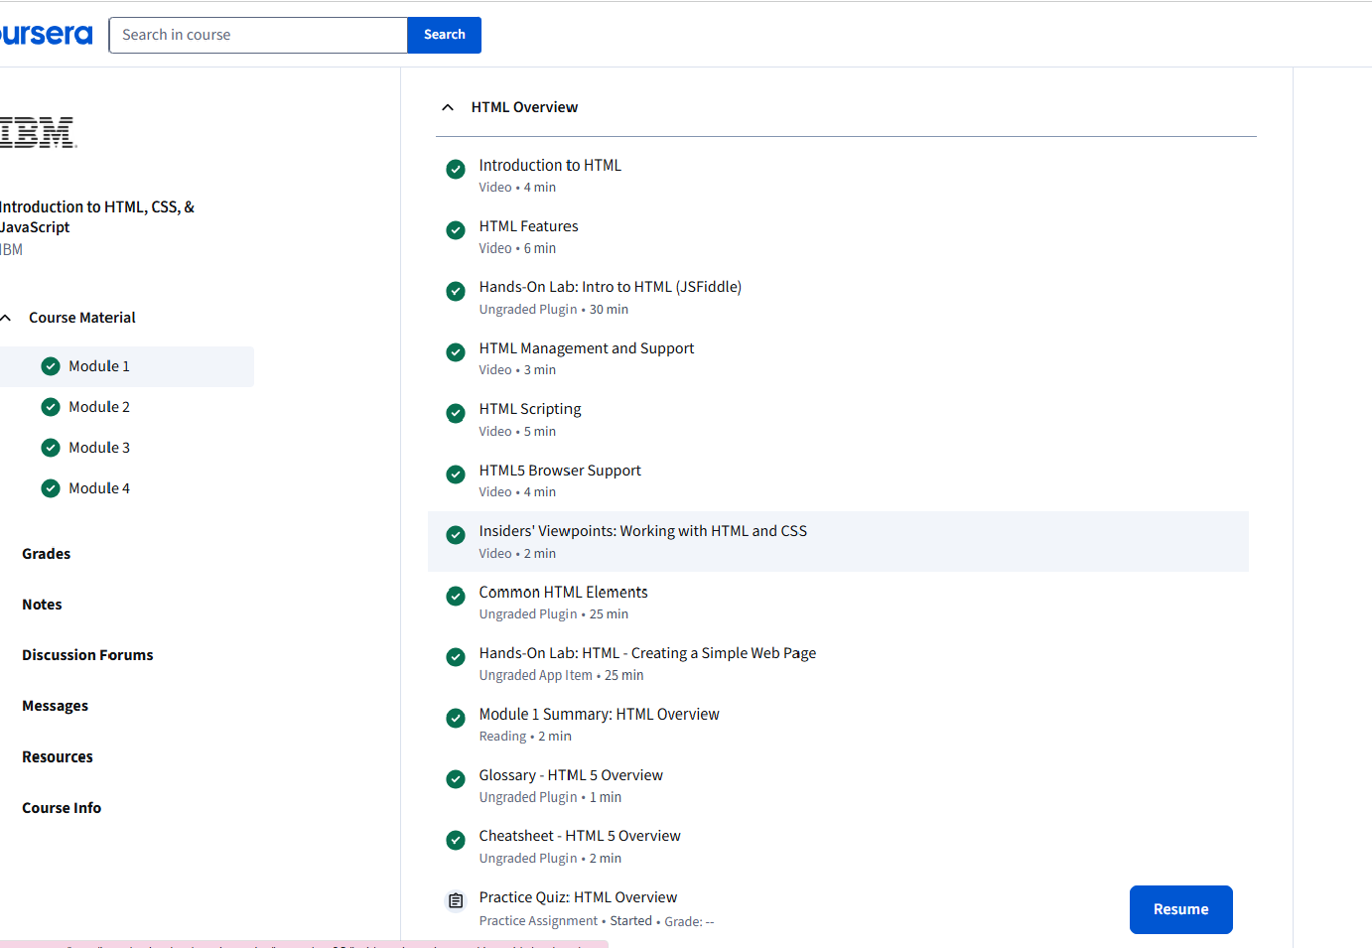

Slide 8
Introduction to Java
Used in mobile apps
Used in web applications
Used in enterprise systems

Slide 9
Why Java Is Important
Used in mobile apps
Used in web applications
Used in enterprise systems
Strong community suppor

Slide 10
CSS Box Model
The box model consists of margin, border, padding, and content.
It helps control spacing and layout.
Layout and Positioning
CSS provides layout tools such as display, positioning, and Flexbox
to arrange elements

Slide 11

Java Basics
Variables
Data types
Operators
Comments

Slide 12
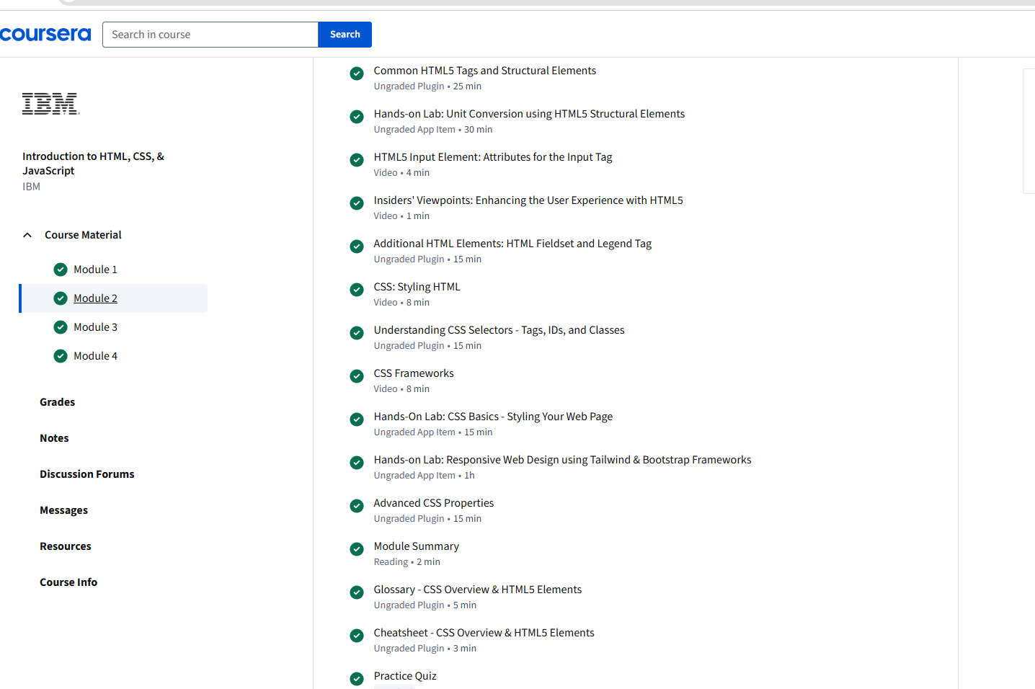

Slide 13
Java Control Structures
If / else statements
Loops (for, while)
Logical conditions

Slide 14
HTML Document Structure
HTML Document Structure
<!DOCTYPE html>
<html>
<head>
<body>

Slide 15
What Is Java
Object-oriented programming language
Platform-independent
Widely used in applications

Slide 16
Module 3: Introduction to HTML
This module introduced HTML, which is used to create the structure of web pages.
I learned about HTML tags, elements, and page structure.
The module explained how to create headings, paragraphs, links, and images.
It helped me understand how web pages are built.

Slide 17
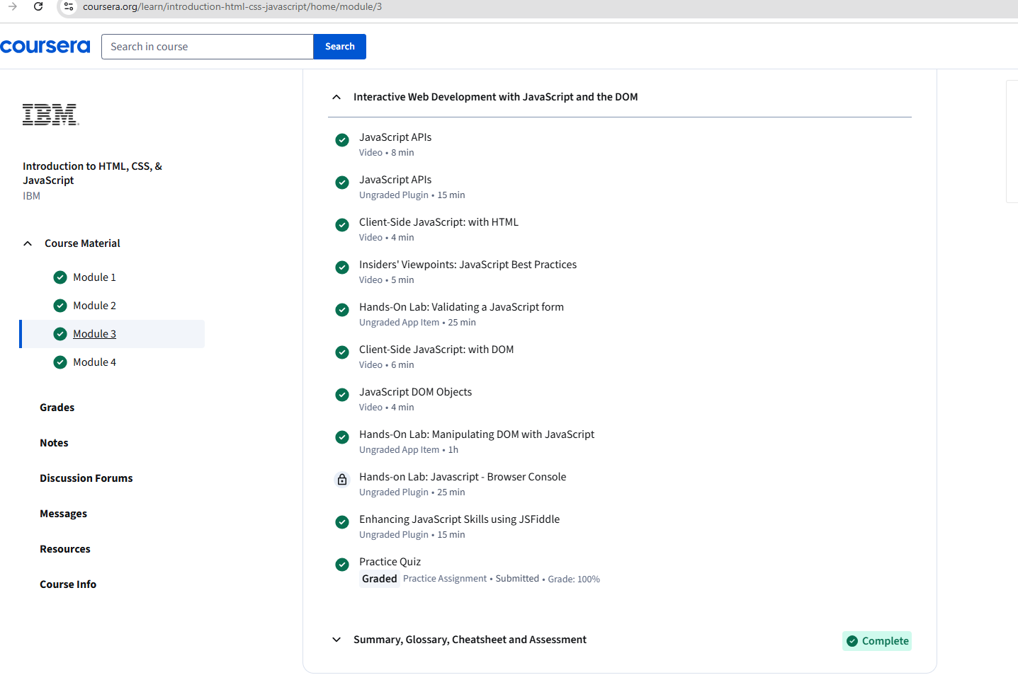

Slide 18
What Is CSS
Cascading Style Sheets
Controls design and layout
Makes websites visually attractive
Slide 12 — CSS Syntax
Selector
Property
Value
Example:
p { color: blue; }

Slide 19
HTML allows creating ordered and unordered lists.
Tables are used to organize data into rows and columns.
HTML Forms
Forms are used to collect user input.
They include text fields, buttons, and input elements.

Slide 20
Common HTML Tags
Headings (<h1>–<h6>)
Paragraph (<p>)
Links (<a>)
Images (<img>)

Slide 21
Module 2: Introduction to Java
This module focused on the fundamentals of the Java programming language.
I learned about variables, data types, operators, and control structures such as if-else statements and loops.
The module also introduced basic Java syntax and simple programs.
It helped me develop a foundation in object-oriented programming.

Slide 22
Java vs JavaScript
Java vs JavaScript
Java ≠ JavaScript
Java: backend, applications
JavaScript: web interaction
Basic Java Syntax
Variables
Data types
Operators

Slide 23
There are three ways to use CSS:
Inline CSS
Internal CSS
External CSS

Slide 24


Ways to Use CSS
Inline CSS
Internal CSS
External CSS
Colors, Fonts, Text
Font size and family
Text alignment
Colors and backgrounds

Slide 25
This module focused on CSS, which is used to style web pages.
I learned how to apply colors, fonts, layouts, and spacing to HTML elements.
The module also explained how CSS improves the visual appearance of websites.
It helped me understand the separation of content and design.
Module 4: Introduction to CSS

Slide 26
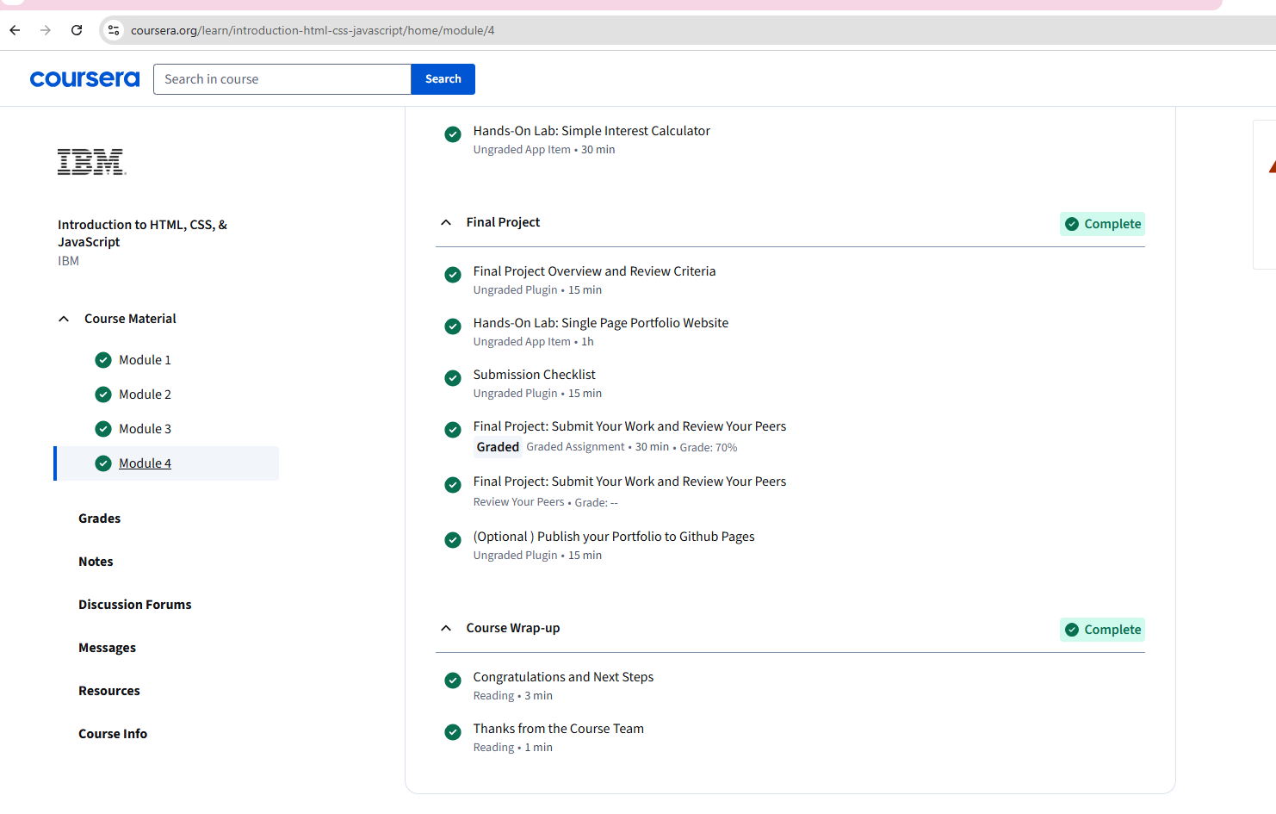
Ways to Use CSS
Inline CSS
Internal CSS
External CSS
Colors, Fonts, Text
Font size and family
Text alignment
Colors and backgrounds

Slide 27
Basic Java Syntax
Variables
Data types
Operators

Slide 28

Box Model
Margin
Border
Padding
Content
Slide 16 — Layout and Positioning
Display types
Flexbox basics
Page structure design

Slide 29
Colors and Fonts
CSS controls colors, fonts,
text size, and alignment,
making websites visually attractive.
Colors and Fonts
CSS controls colors, fonts,
text size, and alignment,
making websites visually attractive.

Slide 30
Conclusion
In conclusion, this Coursera course provided a strong foundation in HTML, CSS, and Java.It helped me understand how websites are structured, styled, and how basic programming logic works.Throughout the course, I learned how to create web pages using HTML, apply design and layout using CSS, and write simple programs using Java.hese skills are essential for anyone who wants to work in web development or software engineering.The course was well-structured and beginner-friendly, making complex topics easy to understand.Practical exercises and tasks helped reinforce theoretical knowledge and improve problem-solving skills.Overall, completing this course increased my confidence in coding and motivated me to continue learning more advanced technologies such as avaScript and frameworks.The knowledge gained from this course will be useful for my future academic projects and professional career.

